Slide 1




HackOrbit 2025
HackSmith

Slide 2

THEME & PROBLEM STATEMENT
Theme: Artificial Intelligence & Machine Learning
Planning a trip today feels more like a chore than an adventure.
Travelers waste 40+ hours juggling 20+ websites—battling decision fatigue, generic suggestions, and endless rework.
Excitement fades as fragmented tools, repetitive searches, and last-minute chaos drain the joy from the journey.
Most tools offer options. But what people truly want is personalized, stress-free transformation from the very first click.
We don’t need another booking site.
We need a travel concierge—one that understands us, guides us, and grows with us.
"People don't want more travel tools—they want transformation.
Radhe makes planning the first magical step of the journey."

Slide 3
PROPOSED SOLUTION
Radhe: AI Travel Concierge with Live Itinerary
🎯 Core Innovation: Multi-Agent Architecture + Real-Time HTML Generation
The Magic Moment
Watch your trip come to life as you talk - each decision instantly updates a beautiful, shareable itinerary.
Key Differentiators
🤖 6 Specialized AI Agents working in concert
📄 Live HTML Itinerary that evolves with conversation
🔍 Google Search Grounding for real-time insights
💬 Single Conversation replaces 20+ websites

Slide 4
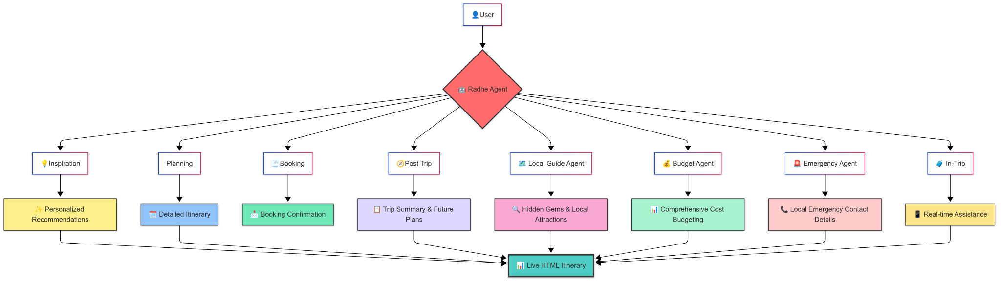
FLOWCHART / DIAGRAM

Slide 5
FLOWCHART / DIAGRAM
🎬 THE RADHE EXPERIENCE
End-to-End Travel Lifecycle Management
🌟 Phase 1: Inspiration & Planning
💡 Inspiration Engine: AI discovers dream destinations based on preferences
📋 Smart Planning: Creates detailed itineraries with real-time optimization
🗓️ Dynamic Scheduling: Adapts to your pace and interests
🎯 Phase 2: Booking & Preparation
🧾 Seamless Booking: Handles reservations across multiple platforms
📩 Instant Confirmations: All details consolidated in one place
🧳 Pre-Trip Prep: Packing lists, weather alerts, travel docs
🚀 Phase 3: Live Travel Support
📱 Real-Time Assistance: 24/7 support during your journey
🗺️ Local Intelligence: Hidden gems and authentic experiences
💰 Budget Tracking: Live expense monitoring and optimization
🚨 Emergency Ready: Instant access to local emergency contacts
🔄 Phase 4: Post-Trip Intelligence
📋 Trip Analytics: Comprehensive summary and insights
🧭 Future Planning: Learns from your preferences for next adventures
Every phase feeds into your Live HTML Itinerary - your complete travel command center

Slide 6
FEATURES AND NOVELTY
🌟 Revolutionary Features
Live HTML Generation - First-ever real-time itinerary updates
Multi-Agent Orchestration - Specialized expertise working together
Conversational UX - Natural dialogue replaces form-filling hell
Google Search Integration - Up-to-the-minute local insights
Interactive Approval System - You're in control at every step
🎯 Technical Innovation
Incremental Decision Making - Step-by-step with instant feedback
Modular Architecture - Easily expandable beyond travel
State Management - Sophisticated coordination across agents
Real-Time Rendering - Beautiful CSS-styled documents

Slide 7
DRAWBACK AND SHOWSTOPPERS
Acknowledged Limitations
API Dependencies → Fallback systems & cached data
Complex Orchestration → Robust state management architecture
Privacy Concerns → End-to-end encryption & data minimization
Development Complexity → Modular design for incremental deployment
🛡️ Risk Mitigation Strategy
Progressive Enhancement - Core features work offline
Graceful Degradation - Single agent fallback mode
Privacy by Design - No sensitive data storage
Iterative Development - MVP with core agents first

Slide 8
HackSmith
🎯 Arpit Singh - Team Leader & Architect
The visionary driving Radhe's multi-agent revolution
📱 Contact: +91-9571845422
📧 Email: arpit2005singh@gmail.com
🔗 LinkedIn: linkedin.com/in/arpit-singh-45433b311
💻 GitHub: github.com/Arpit-Singh320
🏆 Key Strengths:
AI/ML Architecture Design
Multi-Agent System Development
Full-Stack Engineering
Product Vision & Strategy
⚡ Mahi Gupta - Technical Co-Founder
The technical powerhouse making Radhe's vision reality
📱 Contact: +91-7470727294
📧 Email: mahig8828@gmail.com
🔗 LinkedIn: linkedin.com/in/mahi-gupta-124866329
💻 GitHub: github.com/Mahi694
🏆 Key Strengths:
Backend Systems & APIs
Database Architecture
Cloud Infrastructure
System Integration

Slide 9
Thank you

